Slide 1

Enhancing Stock Trading Strategies with Integrated Feature Enhancement & Reward Shaping : A Reinforcement Learning Approach
Student: Wong Kai Yuan (DC026157)
Supervisor: Prof Ryan Leong Hou U
Notes:
Good [morning], everyone. My name is Wong Kai Yuan, and today I'll be presenting my Final Year Project on enhancing stock trading strategies using reinforcement learning.”
(0)

Slide 2
Table of contents
01
02
03
Introduction
Motivation
Background of study
Problem Statement
Methodology for Feature Enhancement
Methodology of Reward Shaping
04
Conclusion
Testing Result
Summary of work
Notes:
Let's begin with an overview of today's presentation. We'll start with the introduction, followed by the methodologies for feature enhancement and reward shaping. Finally, we'll discuss the results of our testing and conclusion

Slide 3
01 Introduction

Slide 4


Motivation
Stock Trading
Advancement of AI
Often heard, but never deeply understood.
Recent years of rapid advancement of AI
Take such an opportunity to delve deeper and learn more about these topics as my FYP
Notes:
Let’s start with the motivation or project. First, stocks trading, always interesting and heard topic but I never deeply understand it. Secondly, recent advancement of AI, like chatgpt. These inspired me to delve deeper and wanna explore these topics comprehensively with my FYP.

Slide 5
Background of study

Slide 6
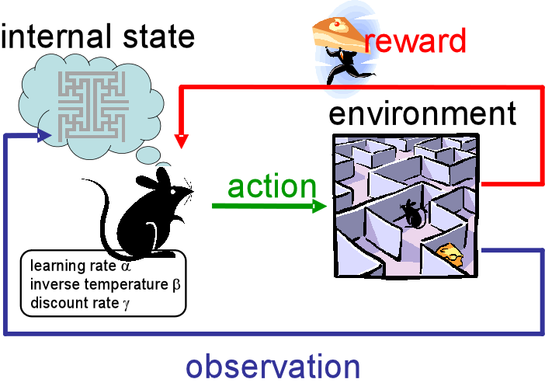
Reinforcement Learning
Branch of Machine Learning
Agent learns to make decision (will receive reward / penalty) by interacting with environment.
Aiming to maximize cumulative rewards. Aka make best decision in long term.
MDP Framework as mathematical framework: (States, Action, Rewards, Transition)
Notes:
RL is a branch of machine learning where an agent learns to make decisions by interacting with the environment, aiming to maximize cumulative rewards over time."

Slide 7

RL Application
In various domains, most notable in mastering complex robotic problems and games at superhuman level, such as AlphaGo.
RL agent able to develop a good strategy from complex and challenging environment.
This make me wonder if RL can perform well in the “game” of stock trading, or at least a good candidate.
Notes:
RL has shown success in various domains, from mastering complex robotic tasks to achieving superhuman performance in games like AlphaGo. This made me curious about its potential in stock trading."

Slide 8
Problem Statement

Slide 9
Problem Statement
Limited Data
Features
Need to admit that Stocks Trading Env is not so RL friendly. Unlike games with extensive rich data, stock trading data is limited to a few lines of prices per stock.
Stock market data is characterized by:
Sparse: Data are low significance.
Noisy: Data has random fluctuations.
Nonstationary: Statistical property of data is not consistent
Reward
Delayed reward: The financial outcomes of trading decisions are often realized after a significant delay, complicating the association between actions and their consequences.
Sparse reward: Profitable trades are infrequent, resulting in sparse rewards that make learning effective trading strategies difficult.
Notes:
Next, look at problem statement, mainly 3. First, need to admin Stock trading environments are not as RL-friendly as games, the data is very limited, just few lines of prices per stock. Secondly, The data is sparse, noisy, nonstationary. And, rewards are delayed and sparse. (financial outcome often realise after significant delay)

Slide 10
Study Focus
To address these challenges, it is crucial to improve the RL agent's ability to perceive data and the ability to make decisions. Therefore, our study focus on:
Feature Enhancement
Reward Shaping
Improving the representation of input data, we aim to provide the RL agent with more informative and relevant features.
By refining the reward function, we aim to provide more meaningful feedback to the RL agent. This encourages good behaviour and stops bad behaviour.
Test the Methodology Developed
Further test the same methodology on other stocks from varies sectors.
Notes:
Therefore, to address previous challneges, our study focus on 2 things, 1st improve ability to perceive data using feature enhancement, 2nd , improve ability to make decision using reward shaping. And, will test our methodology on multiple other stocks from different sector to show robustness.

Slide 11
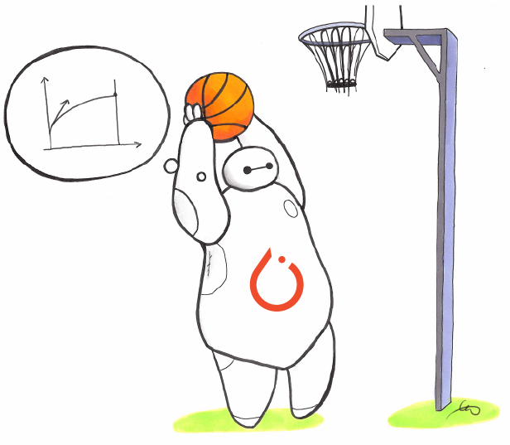

Tools Details
Environment:
AnyTrading Gym with small customization
Algorithm:
PPO from SB3
Data Chosen:
Goldman Sachs Group 10 Years daily data
(95% for training, 5% for testing)
Yahoo Finance
Notes:
Here are some details our tool. For environment, will use Anytrading, 3rd Party gym environment. For Algorithm, will use PPO from stable baseline. For data, will use 10 years daily data of goldman sachs group.

Slide 12
02 Methodology of Feature Enhancement
Notes:
Now, Lets look at what we have done in feature enhancement
(3)

Slide 13
Overview of Feature Enhancement
Original : Basic Data
#1 : Extended Market Data
Methodology
#2 : Integrating Technical Indicators
#3 : Integrating Candlestick Pattern
Notes:
Here’s an overview, starting from basic data, extending market data, integrating technical indicators, lastly, candlestick pattern.

Slide 14
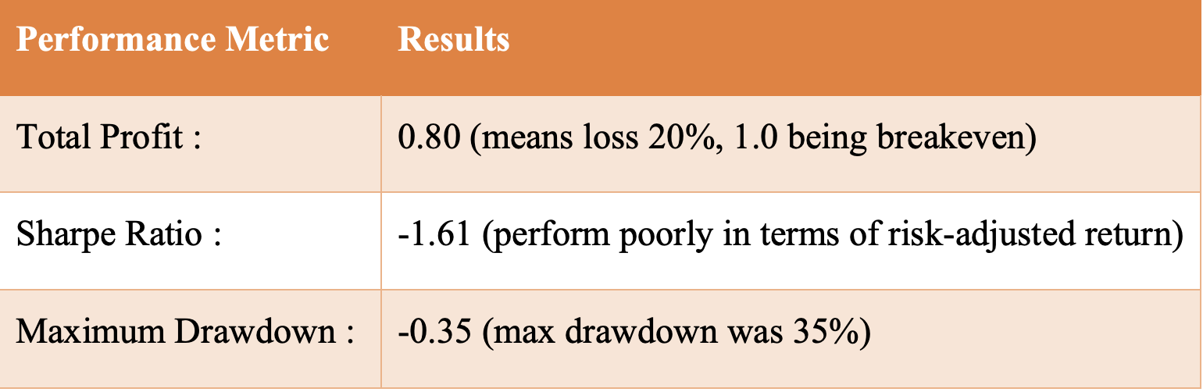
Original Feature Function
Only 2 Features for agent
Close Price
Price Difference
Testing Result
Notes:
Initially, we used only the closing price and price difference as input features. And the testing result is below. Where these performance metric will be used all the way. Total profit means the agent profitability, 1 means breakeven. Below means. Sharpe Ratio is one important metric on risk. High sharpe ratio indicate good risk return.

Slide 15
Original Feature Function
Problem
2 Features as input are insufficient to capture the complex movements of the stock market.
This simplicity led to poor performance metrics, indicating underfitting.
Proposed Solution
Clear that the input features needed to be enriched.
#1 Solution is adding all available columns (like volume) from the dataframe as the input feature.
Our hypothesis is, this will make the model better at capturing more complex market patterns
Notes:
Is clea to see that This simplicity led to poor performance due to underfitting. The model could not capture the complexities of the stock market with just these two features.”
So our first enhancement is to utilize all availblae column from dataframe as feature.

Slide 16
#1 Feature Enhancement
Extended Market Data
Dataset column include ["Open", "Close", "Low", "High", "Volume", "Adj Close"]
Along with the day-over-day differences for each column
Resulting in a total of 12 features.
Rationale
Provide richer features for agent like Volume and Price Difference
Model can potentially identify more complex patterns
Hence, resulting in better predictive accuracy.
Notes:
To enrich the input features, we added columns like 'Open', 'Close', 'Low', 'High', 'Volume', and 'Adj Close', along with day-over-day differences, resulting in 12 features.
Rationale of such enhancement is
Including more features such as volume and price differences helps the model identify more nuanced market trends, leading to better predictive accuracy and performance

Slide 17
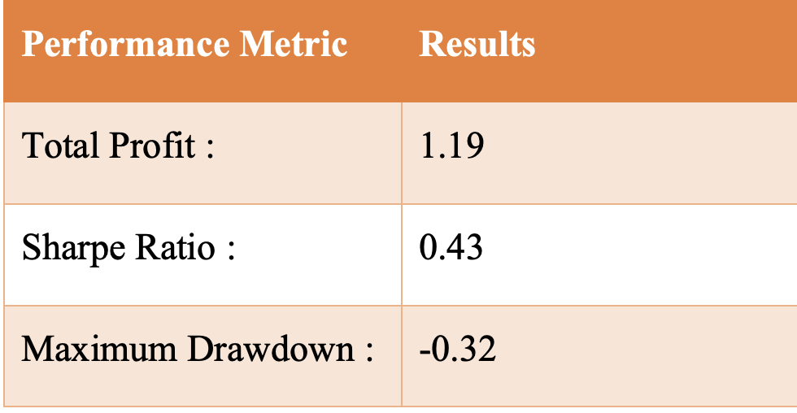
#1 Feature Enhancement
Testing Result
Discussion
Result supported the hypothesis where adding more data helps agent learn better.
This motivate us to add more relevant features, which lead to #2 Feature Enhancement (add Technical Indicators)
noticeable improvement !
Notes:
There are noticeable improvement after 1st feature enhancement, which support the hypothesis where adding more data make agent better. This motivates us to add more relevant data, which lead to 2nd feature enhancement.

Slide 18
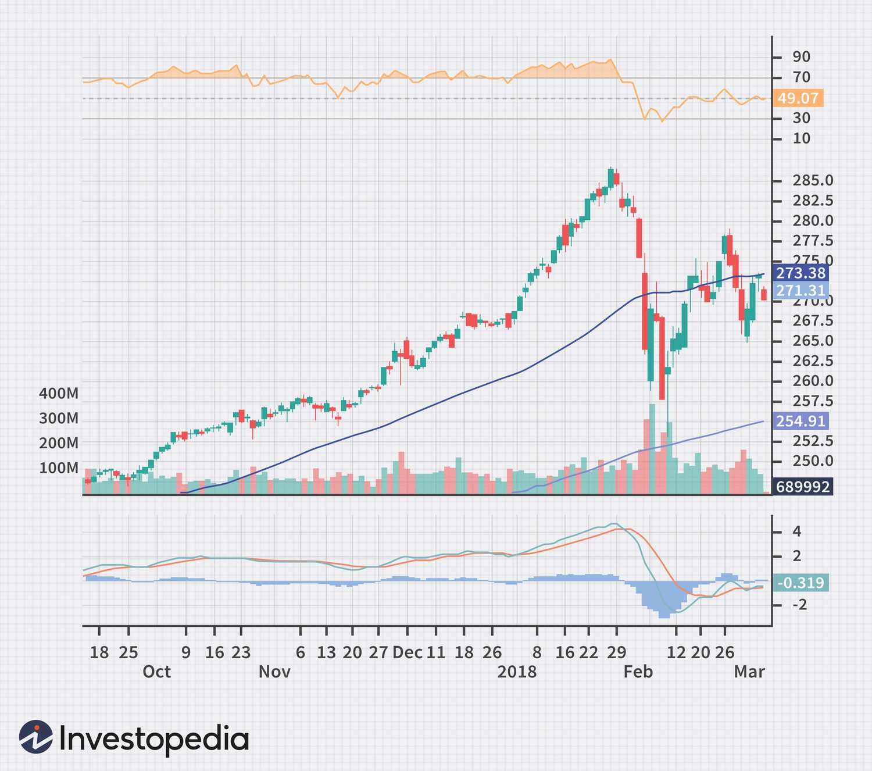
#2 Feature Enhancement
Integrating Technical Indicators
Technical Indicators have proven to be useful in financial analysis.
Provide insights of market trend, momentum, and volatility not direct from raw price data.
Example: MACD, RSI, Bollinger Bands.. To provide comprehensive view.
Notes:
Which is, Integrating with Technical Indicators. TI have proven to be useful in financial analysis as it provide insights like momently , not difrect observe raw data.

Slide 19
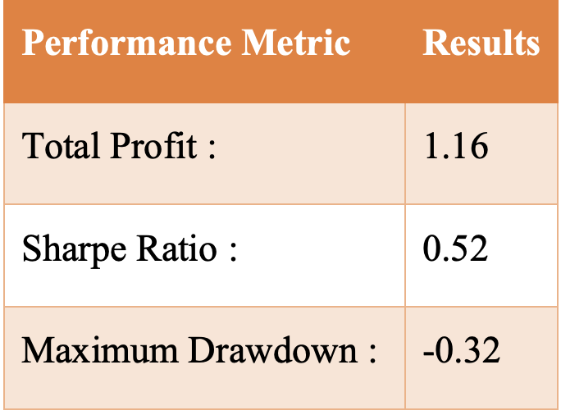
#2 Feature Enhancement
Initial Result
Problem Identification
Result not showing improvement as expected.
Observation :
Training & Validation Loss are high
Model might not fitting well and not able to learn pattern from training data.
Therefore, model architecture might need to change.
Notes:
However, the initial integration of technical indicators showed not good results as expected, with high training and validation loss, indicating that the model architecture needed to be adjusted to handle the additional complexity."

Slide 20
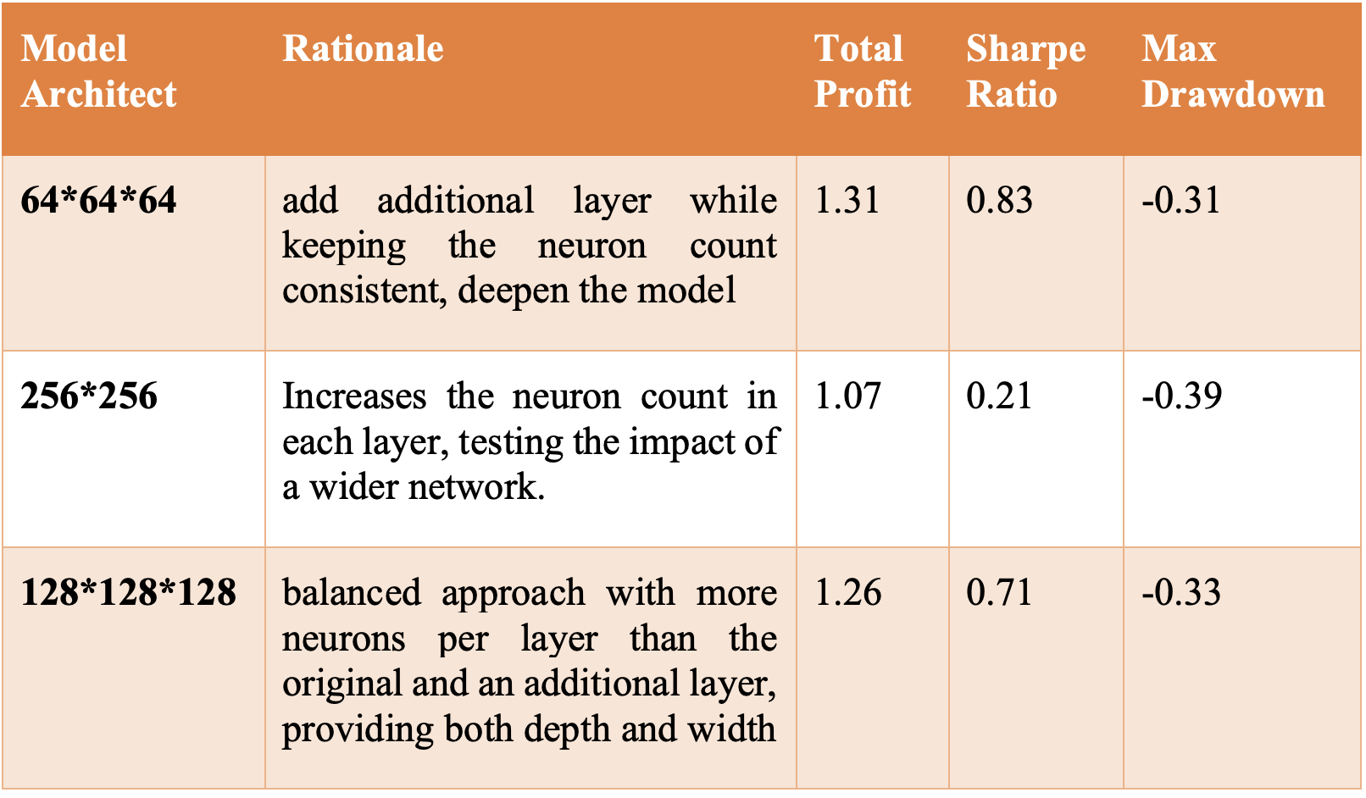
#2 Feature Enhancement
Modification of Model Architecture
Experiment with deeper architecture from original 64*64
64*64*64 :
Balanced Complexity
Resource Efficiency
Better Learning capability
Notes:
Therefore, multiple experiements was carried out with deeper architecture from original 64*64. For example, 64*64*64, 256*256 and 128*128*128.
Lastly, we change our network to 64*64*64 as it’s balanced complexity, resource efficiency (train faster than others), and better learning capability (as you can see from the table, it yields best result)

Slide 21
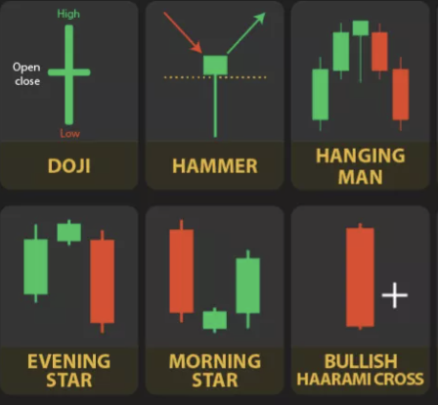
#3 Feature Enhancement
Integrating Candlestick Pattern
Candlestick pattern are pattern found by finance elites that used to predict next price movement.
Rationale
Technical Indicators often lag the market, as it’s calculated from past.
Candlestick show future price movement
Hypothesis :
Candlestick = Better predicting.
Notes:
Next, we further integrate candlestick pattern, If you don’t know what’s candlestick pattern, its’ something like this. The rationale of integrating candlestick pattern is because TI often lag the market, and candlestick pattern often used to predict future price movement. Therefore, how hypothesis here is candlestick pattern, will make agent better at predicting

Slide 22
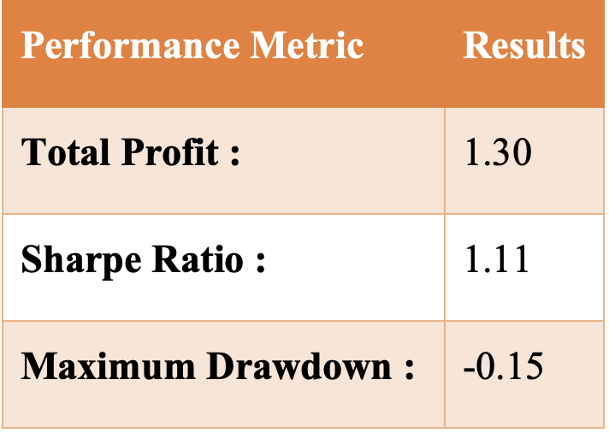
#3 Feature Enhancement
Testing Result
Discussion
Reason why not performing well:
The prediction of the candlestick pattern is not necessarily true
Candlestick pattern data is usually sparse; not every time frame shows a clear pattern
Still, remain potential as it has most numbers of features. At this stage, it might be more beneficial to shift focus to reward shaping (next phase of our study)
Not improving much !
Notes:
We integrated these patterns into our model, but this actually did not significantly improve performance, likely due to the sparsity of pattern data (because is 0 if no pattern found, 1 if pattern found, so the data consist a lot of 0) also predicting power of candlestick pattern not always true. Despite this, candlestick patterns remain valuable as they provide a different perspective on market behavior.” At this stage, might be more beneficial to shift focus to reward shaping which is next phase of our study.

Slide 23
03 Methodology of Reward Shaping
Notes:
(7)

Slide 24
Overview of Reward Shaping
Ori : Proportional Reward & Penalty
#1 : Behavioral Reward
Methodology
#2 : Risk Handling via Thresholding
#3 : Avoid Overconfidence
Notes:
Reward shaping is essential for guiding the RL agent's learning process. We explored three reward shaping strategies: behavioral rewards, risk handling via thresholding, and avoiding overconfidence."

Slide 25
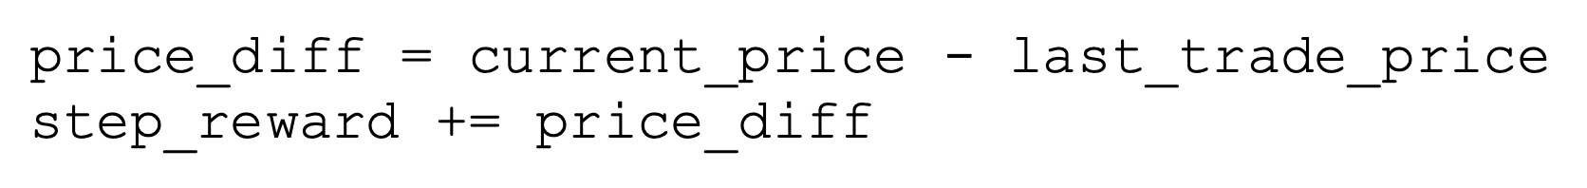
Original Reward Function
Proportional Reward & Penalty
Direct reward and penalty based on the agent's action that leads to price difference of current trade and previous trade
Problem
Too simple. Only cares about short-term gains from trading, no longer financial goals like long-term growth, risk management, or capital preservation.
Doesn't have dynamic ways to change the rewards.
Notes:
The initial reward function was simple, It rewarded the agent based on the price difference between trades. The problem here is that it only focusing only on short-term gains without considering long-term financial goals. which was insufficient for effective learning

Slide 26
#1 Reward Shaping
Static Weight on losses
Reward and penalty are treated differently
Losses have a bigger effect on the person than gains (1.2 multiply to be exact)
Rationale
Aligning with a principle of behavioural finance called loss aversion.
RL agent will avoid losses rather than pursuing equivalent winnings
Hypothesis:
The agent can come up with a strategy that prioritise capital preservation first
Notes:
The first reward shaping align with behavioral finance principles -> Loss aversion, we introduced a reward function where losses had a greater impact than gains. Losses were multiplied by a factor of 1.2 to encourage the agent to avoid losses
The hypothesis here is that
This approach encourages the agent to prioritize capital preservation over short-term gains, potentially leading to more robust trading strategies

Slide 27
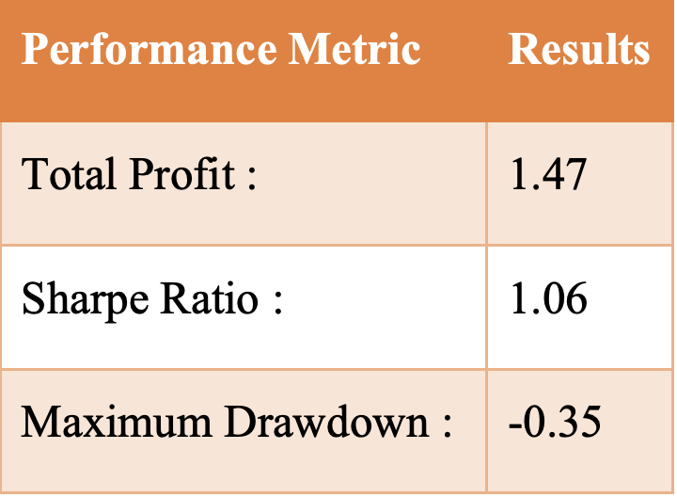
#1 Reward Shaping
Testing Result
Discussion
Result improving, but there’s one visible problem: static weights
Therefore, doesn’t change as market condition change.
Effort can be made on designing dynamic weights.
Improving
Notes:
The result was promising, but slight improvement can be made, which is the weight is static now. Therfore, it doesn’t change when the market condition is changing.

Slide 28
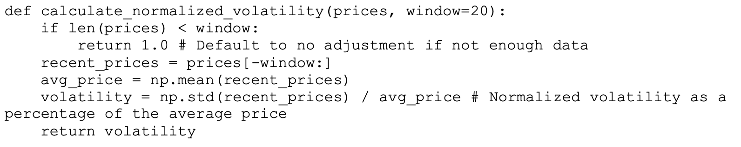
#1 Reward Shaping
Dynamic Weight on losses
Penalty weight calculated by 20 days volatility.
When market unstable (volatility high), penalty for losses goes up
When market stable (volatility low), penalty is smaller.
Code Snippet
Notes:
To address the issue of static weights, we made the penalty weight dynamic, calculated based on market volatility. During periods of high volatility, the penalty for losses increased, and during stable periods, the penalty decreased. Here is a code snippet of calculation of volatility

Slide 29
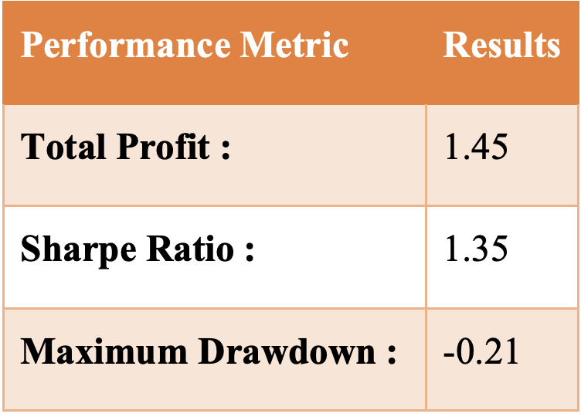
#1 Reward Shaping
Testing Result
Discussion
Similar result as static weight, but much more reliable where:
Sharpe Ratio is higher
Max Drawdown is lower
We can continue develop reward function to multi objective like risk handling (#2 reward shaping)
Notes:
Here, the result are similar with static weight, but showing realibility where the sharpe ratio is actually higher, and max drawdown is actually lower. Here, our strategy is based on capital preservation. Next, we continue develop reward function to much multiple objectives, which is risk handling.

Slide 30
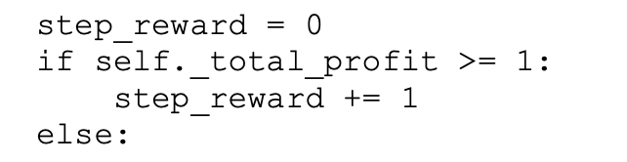
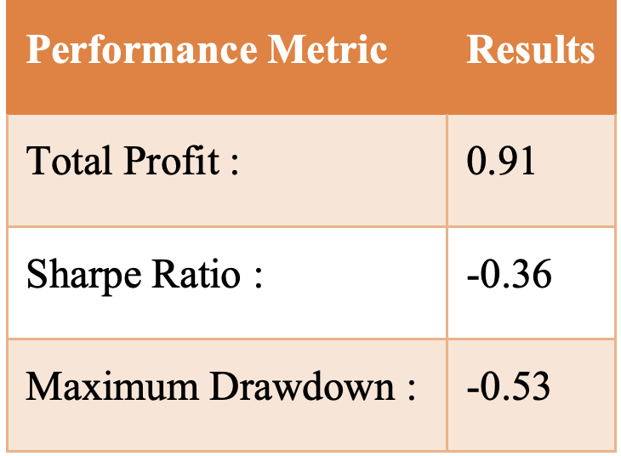
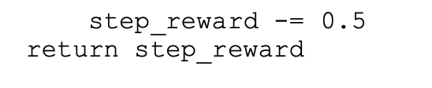
#2 Reward Shaping
Risk Handling via thresholding
Directly encourage our trading methods to keep risk under control
Small reward for agent if stay above threshold, penalty if below.
Testing Result
Notes:
We encouraged risk management by rewarding the agent for staying above a profit threshold and penalizing it for falling below. However, this approach showed limited improvement (should say decrease in performance)

Slide 31
#2 Reward Shaping
Problem
Overall performance went down.
Problem observe: Due to simple profit threshold and fix nature of weight.
Iterative Improvement
Multiple efforts were made like trying different threshold, turning into dynamic weights.
However, there is persistent of bad performance from reward shaping based on thresholding.
Simplifying complex environment into binary cases might not be a good idea. We shall move to another angle
Notes:
The problem here is obvious, where it’s based on simple profit threshold and fix nature of weight. Therefore, We iterated on this approach by trying different thresholds and dynamic weights, however, none of them seems promising where consistent of bad performance. In conclusion, Simplifying the complex trading environment into binary cases proved to be less effective."

Slide 32
#3 Reward Shaping
Risk Handling via Avoid Overconfidence
Look for new way to handle risk.
Look into behavior of RL, problem of overtrading.
Penalty agent if trading too much (3 trades in 10 window)
Rationale
By controlling how often the trades happen, improve the model's general risk management.
Hypothesis :
Reduce possibilities of losses & Focus on high quality trades
Notes:
Try risk handling with different approach, which is looking into behavior of agent, specifically on problem of overtrading. we penalized the agent for making too many trades within a short period, specifically if it made more than three trades in a 10-window frame."
This approach aimed to control trading frequency, focusing on high-quality trades.

Slide 33
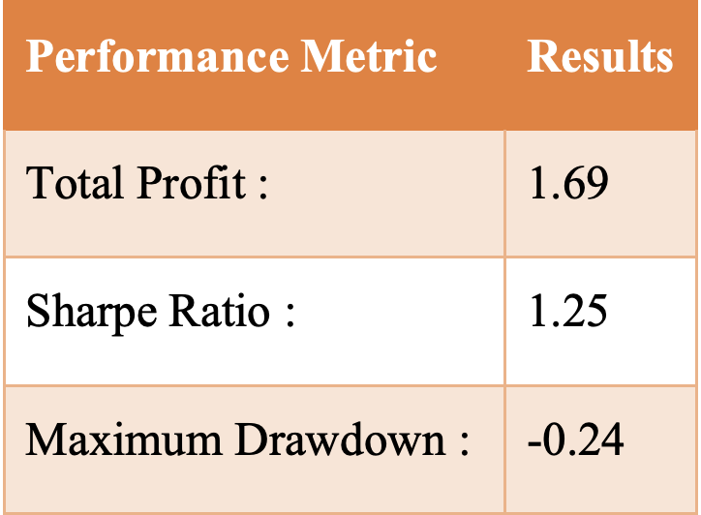
#3 Reward Shaping
Testing Result
Discussion
Very easy modification, but show significant result, which contrast with previous reward shaping (no need to have much complex reward function)
The improved performance confirms our hypothesis.
Notes:
This simple modification significantly improved performance, confirming our hypothesis that fewer, more quality trades lead to better results."

Slide 34
04 Conclusion
Notes:
(11)

Slide 35
4.1
Testing Result

Slide 36
Cross-Stock Testing
Rationale
To validate our methodology beyond the original Goldman Sachs (GS) stock dataset, we tested it on multiple stocks. This approach ensures that our strategies for feature enhancement and reward shaping are effective across various market conditions and stock types.
Stocks Selection
Diverse range of stocks to ensure the model handles various scenarios, including
APPL (Apple) | Technology
COST (Costco) | Retail
PFE (Pfizer) | Pharmaceuticals
KO (Cola) | Consumer Goods
XOM (ExxonMobil) | Energy
Same Training & Testing Process
Same Model configuration
Same Methodology
Same Evaluation
Notes:
To validate our methodology stays effective across various market condition, we tested it on diverse stocks like Apple, Costco, Pfizer, Cola, and ExxonMobil. They are from different sectors. Each of them will go trhough same training testing, model confirmation, methodology and evaluation.

Slide 37
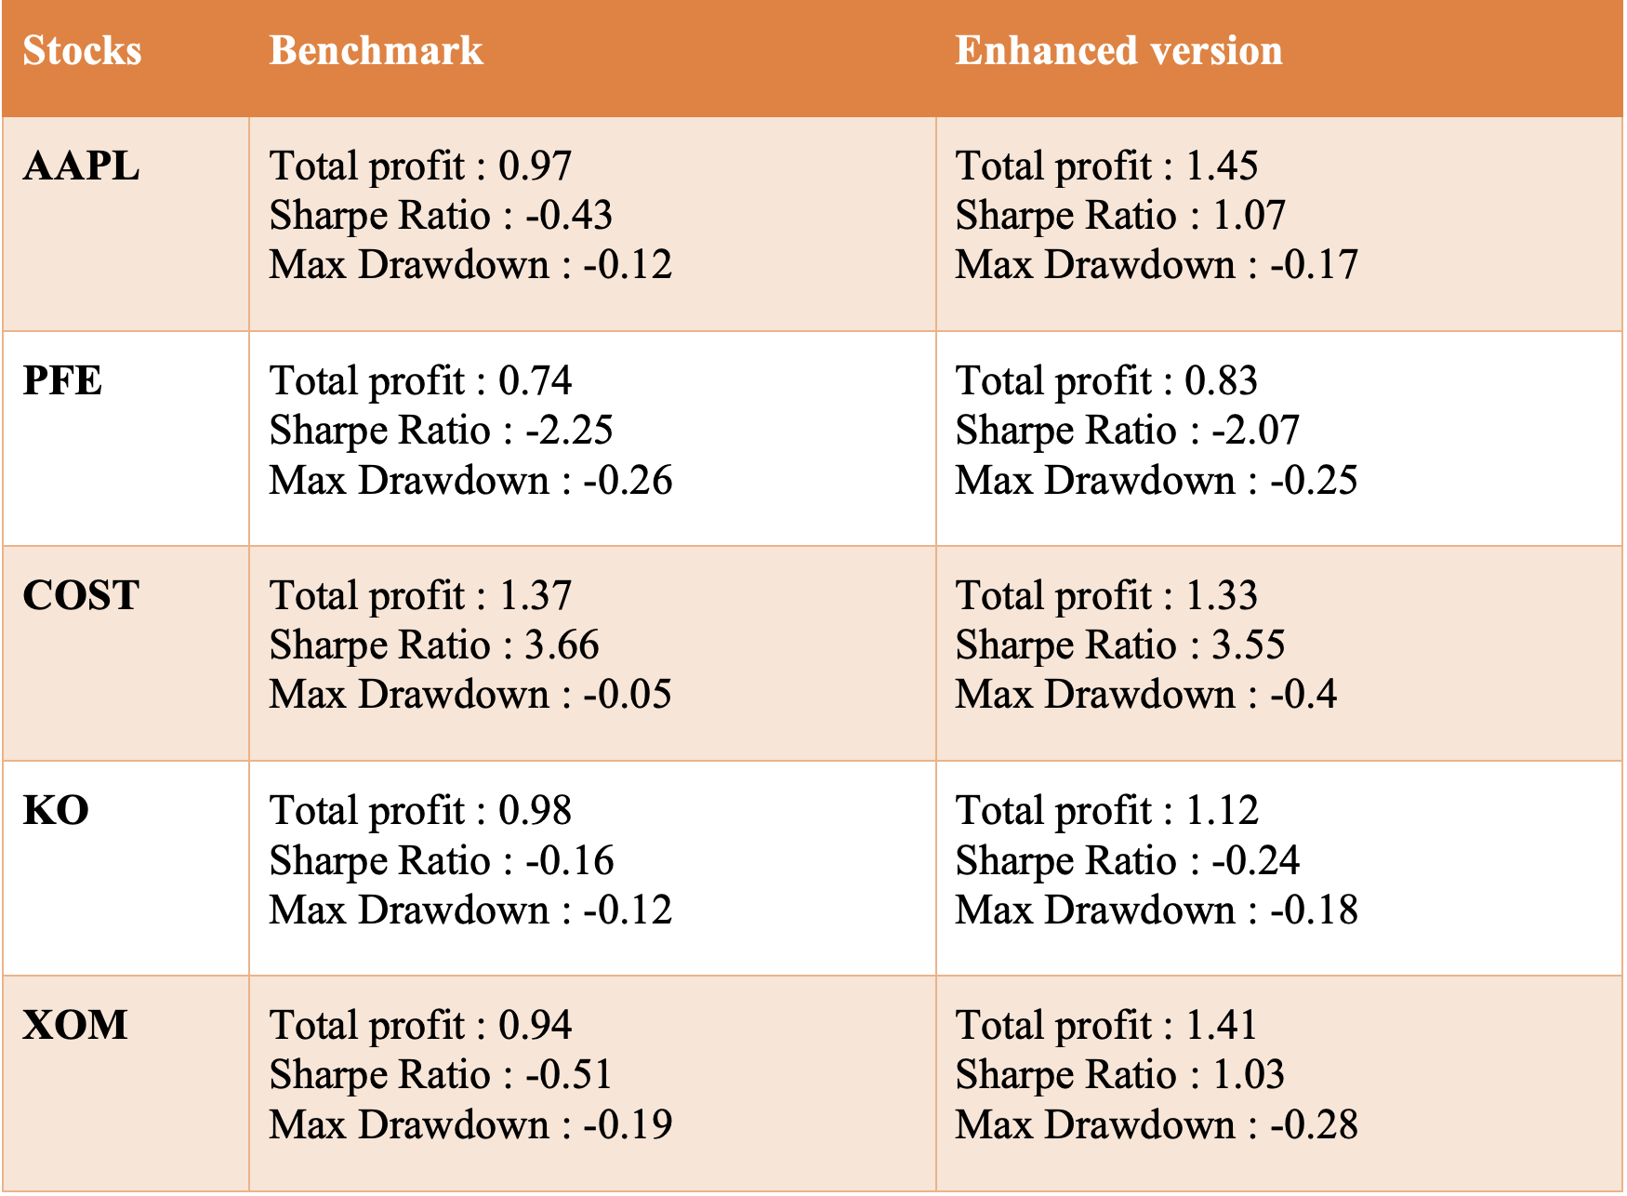
Notes:
Here’s the result. Left showing benchmark, which is the buy and hold strategy, where right side is integrating feature enhancement with reward shaping.

Slide 38
Good
The improved models, integrating feature enhancement and reward shaping, outperformed the simple "buy and hold" benchmarks for most stocks
This success indicates the potential effectiveness of advanced RL methods in stock trading strategies.
Bad
Stocks like Costco showed limited improvement in overall profit and Sharpe ratio.
The methods were less effective in stable sectors with limited growth potential.
Possible Reason: Reward shaping focused more on risk management than on maximizing profit.
Take Away : Customizing reward functions and hyperparameters for each stock based on its unique characteristics could further enhance results.
Notes:
The Good part is most Our improved models outperformed simple 'buy and hold' benchmarks, demonstrating the potential of advanced RL methods in stock trading.”
However, stocks like Costco actually show limited improvement, the potential reason might be reward shaping based on risk management, than miximizing profit.
So the take away is, always can customize reward function and hyperparam for each stock based on its chatracteristic for better results.

Slide 39
4.2
Summary of Work

Slide 40
Summary of Work
Feature Enhancement
Start with basic price data, to extended, to Technical Indicators, lastly candlestick pattern.
Reward Shaping
From Proportional reward and penalty, to static weight, to dynamic weight. Then, risk management with 2 approach, which is thresholding and avoid overconfidence.
Testing
Cross-stock validation to show the methodology is working.
Notes:
In summary, we enhanced features from basic price data to technical indicators and candlestick patterns, and refined the reward function from proportional rewards to dynamic weights and risk management strategies. Our cross-stock validation showed promising results.

Slide 41
What I’ve Learned
Application of Reinforcement Learning
Basic knowledge of Stock Trading
Importance of Feature Enhancement
Reward Shaping as double edge sword
Always learn from mistakes
Importance of Iterative Improvement
Notes:
Throughout this project, I learned about the application of RL, some basic knowledege in stock trading, the importance of feature enhancement, iterative improvement, and the double-edged nature of reward shaping.”
(13)

Slide 42
Thanks!
Do you have any questions?
dc02615@umac.mo
Notes:
Thank you for your attention. Do you have any questions?

